Slide 1


Madanapalle Institute of Technology & Science, Madanapalle UGC-AUTONOMOUS INSTITUTION Affiliated to JNTUA, Ananthapuramu & Approved by AICTE, New Delhi
M I T S
Department of Computer Science & Technology
Review: 3rd
A VISION-BASED DRIVER DROWSINESS DETECTION FRAMEWORK FOR ROAD SAFETY ENHANCEMENT
Project Guide:
Mrs.P.Jayaselvi Project Members:
Assistant Professor/CST Roll No: 21691A2869 - P.Kavya
21691A2873 - U.Lavanya
21691A28D2 - N.Rajesh
22695A2812 - M.Prasanth

Slide 2
ABSTRACT
Driver drowsiness and distraction are major causes of road accidents, posing significant threats to road safety. It aims to develop an advanced driver monitoring system that leverages YOLO V5 (You Only Look Once) object detection to detect early signs of drowsiness and distraction. The system uses a custom dataset to analyse key facial features, such as eye closure, head tilting, and position changes, to detect drowsiness. Additionally, it incorporates two critical features: automatic call detection, distraction alertness. The automatic call detection feature identifies when the driver is engaged in a call, ensuring that distractions are minimized. The distraction alertness feature triggers an alert when abnormal head movement or position changes are detected, indicating possible fatigue or distraction. a key indicator of drowsiness. It reduces accidents caused by driver fatigue and distraction by offering timely alerts, thereby improving overall road safety.

Slide 3
INTRODUCTION
Driver drowsiness and distraction are leading causes of road accidents, posing serious risks to safety. This project presents a driver monitoring system using YOLO (You Only Look Once) object detection to identify signs of fatigue and inattentiveness. By analyzing eye closure, head tilting, and positional changes, the system accurately detects drowsiness. It incorporates three key features: automatic call detection, distraction alertness, and yawning detection. Call detection minimizes distractions, distraction alertness monitors abnormal movements, and yawning detection identifies excessive yawning. By issuing timely alerts, this system helps prevent accidents caused by fatigue and distraction, ultimately improving road safety.

Slide 4
SCOPE AND OBJECTIVE
It is to enhance road safety by monitoring drivers in real-time and identifying signs of drowsiness, distractions, and fatigue. The system uses advanced techniques like eye-tracking and yawn detection to detect drowsiness and alerts the driver to prevent accidents. We include automatic call detection to reduce distractions and distraction alerts to ensure the driver stays focused on the road.
Objective :
It improve road safety by incorporating real-time monitoring of drivers using facial and eye-tracking techniques to detect drowsiness. It includes identify signs of fatigue and distraction alerts to ensure drivers stay focused on the road. Additionally, the system features automatic call detection to reduce distractions and integrates alert mechanisms to notify drivers of potential hazards.

Slide 5
LITERATURE SURVEY ON TOPIC AND METHODOLOGY
S.No | Paper Name | Algorithm Used | Solutions | Drawbacks
1 | Systematic Review on Driver Drowsiness Detection Using Eye Activity Measures Author: AHMET KOLUS Year: 2024 | Eye activity-based algorithms like PERCLOS, Saccadic Eye Movement analysis Method:Accuracy, Sensitivity, Specificity | Comprehensive review of eye-based DDD; categorized systems into machine-learning-based and non-machine-learning-based methods​ CNN-based models using eyelid movement (PERCLOS) achieved the best performance with accuracy | Limited effectiveness when only eye-based measures are used; dataset diversity remains a challenge Eye-based methods alone can miss multimodal cues; limited by dataset diversity​​
2 | Drowsiness Detection in Real-Time via CNN and Transfer Learning Author: Dina Salem and Mohamed Waleed Year: 2024 | Convolutional Neural Networks (CNN) with Transfer Learning Method: Accuracy (Multi-class: 90%) | CNN combined with Transfer Learning achieved the highest accuracy using the custom YAWDD+CEW dataset​. | Overfitting when using certain datasets; dependence on quality of accurated datasets​

Slide 6
S.No | Paper Name | Algorithm Used | Solutions | Drawbacks
3 | A Review of Recent Developments in Driver Drowsiness Detection Systems Year: 2022 Author: Yaman Albadawi, Maen Takruri, Mohammed Awad | Various (SVM, KNN, CNN, ANN) for image-based, biological-based, and hybrid systems. Method: Accuracy, Sensitivity, Precision | Summarized DDD systems; classified systems into 4 categories based on input data type; highlighted key performance metrics. Image-based measures using CNN achieved the highest accuracy using the NTHU-DDD dataset​ | High cost and intrusiveness of biological and hybrid-based systems; limited generalizability in real-world settings​
4 | Survey on State-of-the-Art Drowsiness Detection Techniques Authors: muhammad ramzan, hikmat ullah khan, shahid mahmoodawan, amina ismail, mahwish ilyas, ahsan mahmood Year: 2019 | SVM, Hidden Markov Models (HMM), CNN Method: F1-Score,Accuracy,Precision,Recall | Comprehensive comparison of different detection techniques based on physiological, behavioral, and vehicular parameters | HMM struggles with facial occlusions, CNN requires high computational power, physiological methods are intrusive​

Slide 7
S.No | Paper Name | Algorithm Used | Solutions | Drawbacks
5 | Driver Drowsiness Detection System Authors: Belal ALSHAQAQI, Abdullah Salem BAQUHAIZEL, Mohamed El Amine OUIS, Meriem BOUMEHED, Abdelaziz OUAMR, Mokhtar KECHE Year: 2013 | Algorithm: Face Detection using Symmetry, Eyes Localization using Symmetry, Eye State Detection using Hough Transform for Circles (HTC), Tracking with Sum of Absolute Differences (SAD) Evaluation Metrics: Accuracy of eye state detection, False detection rate | The model successfully detects drowsiness based on PERCLOS using an IR camera. It provides high accuracy in both day and night conditions. | Limited to infrared cameras, which may not be available in all vehicles. - Performance may degrade in extreme lighting conditions. - Requires further

Slide 8
S.No | Paper Name | Algorithm Used | Solutions | Drawbacks
6 | Real-time Driver Drowsiness Detection using Computer Vision Authors: Mahek Jain, Bhavya Bhagerathi, Sowmyarani C N Year: 2021 | Eye Aspect Ratio (EAR) for eye closure detection Mouth Aspect Ratio (MAR) for yawning detection OpenCV with Haar Cascades for face tracking Method: Accuracy | - Used Raspberry Pi camera for real-time monitoring - Integrated eSpeak module for voice alerts - Designed to be affordable and efficient | - Not effective at night (required night-vision cameras) - Dataset too small (affected generalization) - Assumes fixed blink duration, which varies per person
7 | Real-time Driver Drowsiness Detection using Deep Learning Authors: Md. Tanvir Ahammed Dipu, Syeda Sumbul Hossain, Yeasir Arafat, Fatama Binta Rafiq Year: 2021 | MobileNet CNN Architecture - Single Shot Multibox Detector (SSD) - TensorFlow Object Detection API- MobileNet CNN Architecture - Single Shot Multibox Detector (SSD) - TensorFlow Object Detection API Method:Mean Average Precision, Precision,Recall | - Used MobileNet-SSD for lightweight, real-time detection - Processed video streams to detect eye closure and yawning - Implemented using Raspberry Pi 3/IP cameras for cost-effectiveness. | - Performance drop in low-light conditions - Dataset lacked low-light images - Suggested better SSD_MobileNet architecture

Slide 9
RESEARCH GAP IN LITERATURE REVIEW
Limited Real-World Testing: It controlled driving simulations, there is a lack of real-world application in various driving conditions.
Lack of Multi-Feature Integration: It focus on individual parameters such as eye movement or vehicle behaviour, leading to limited accuracy in detecting early signs of drowsiness
Non-Intrusive and Real-Time Solutions: It offer high accuracy, they are often invasive and not feasible for real-time driving applications. Many current methods, including those based on facial expressions and eye tracking, face challenges such as obstructions.
Ethical and Privacy Concerns: There is growing concern about the privacy of drivers when using physiological sensors and video-based monitoring. As these techniques may involve monitoring sensitive personal data, ensuring privacy while collecting and processing such data is a challenge that needs further attention.

Slide 10
PREVIOUS REVIEW COMMENTS
Concentrate on addition Features
Concentrate on the Implementation

Slide 11
INCORPORATED MODIFICATIONS
We change the implementation
We added additional features

Slide 12
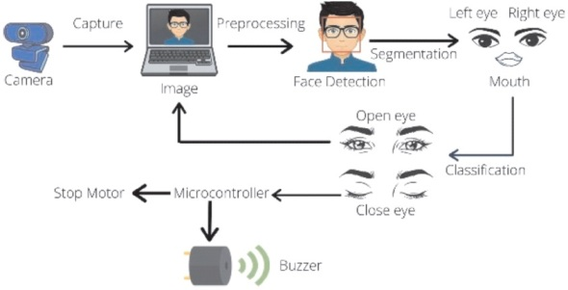
Architecture:

Slide 13
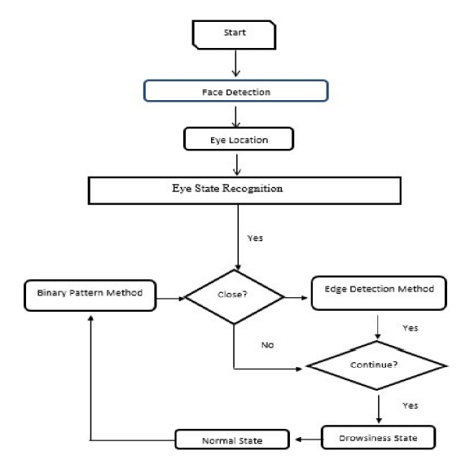
MODULES / PHASES

Slide 14
DATASET
This custom dataset for driver drowsiness detection includes images of drivers when is drowsy state and distracted states. It focus on automatic call detection and distraction alertness. Data is annotated with bounding boxes and stored in YOLO format. The dataset ensures real-world adaptability, improving deep learning model accuracy and road safety.

Slide 15
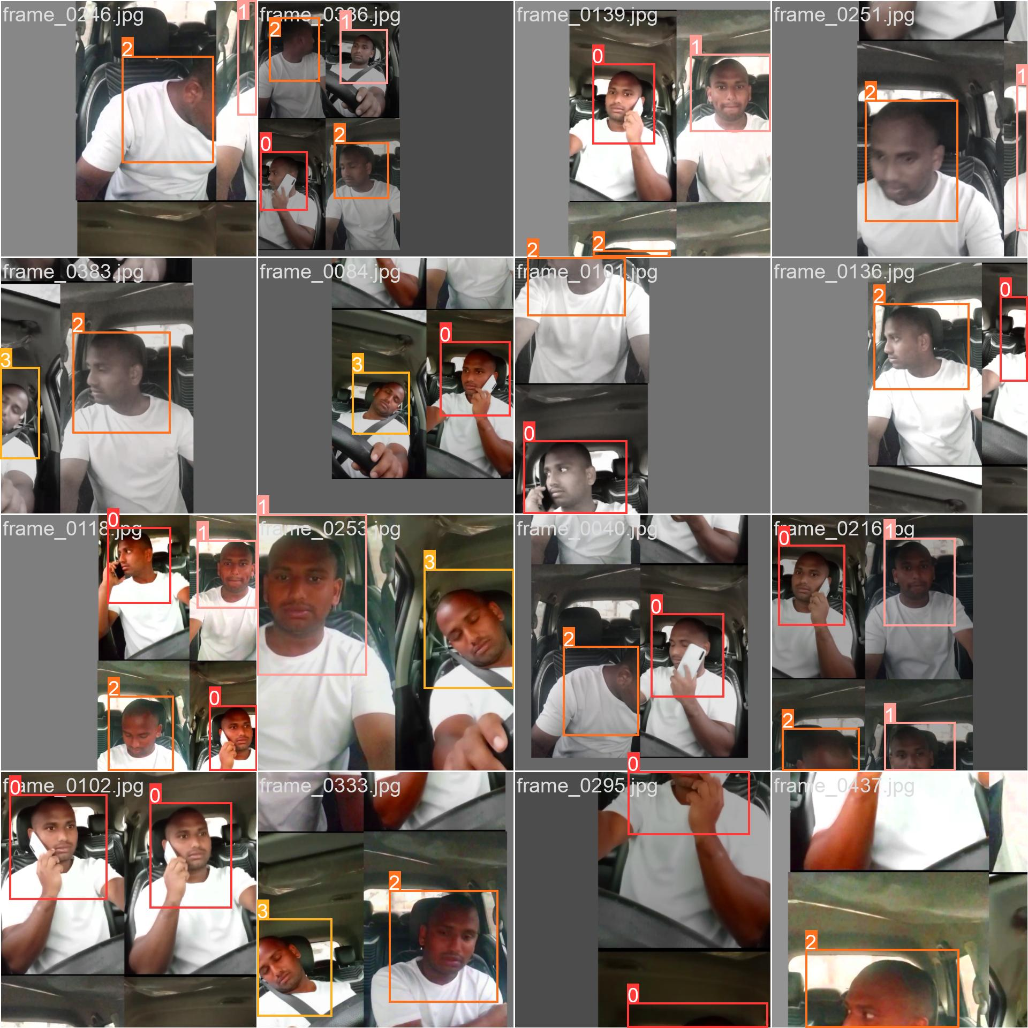
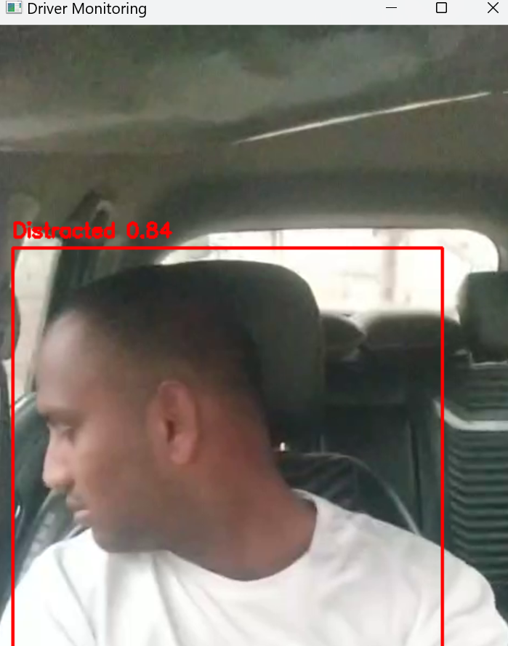
INPUT & OUTCOME

Slide 16
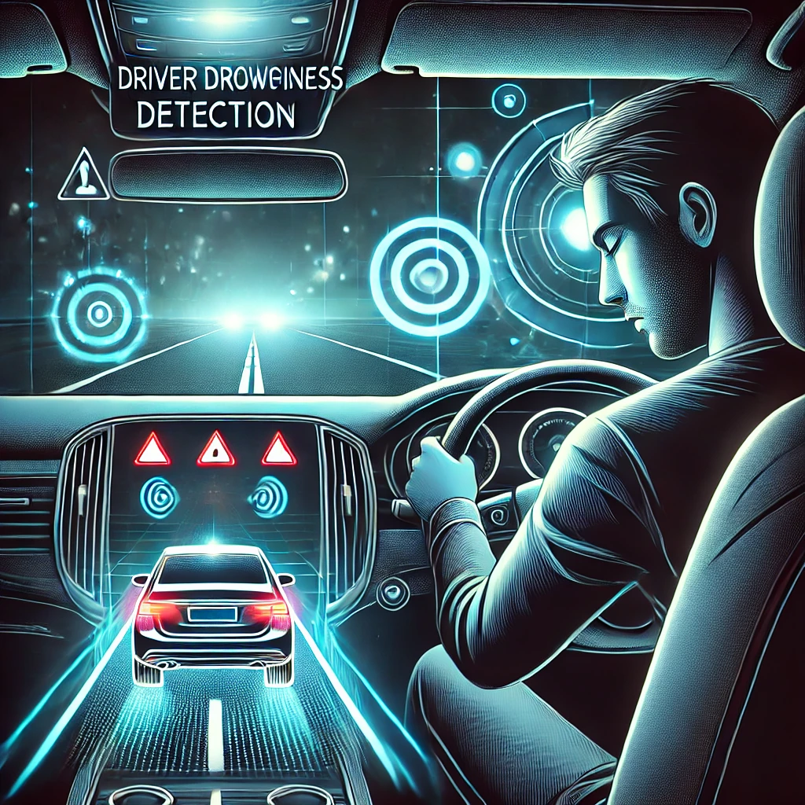
METHODOLOGY OF THE PROPOSED WORK IN DETAIL
Data Collection:
Custom Dataset Creation: A custom dataset will be developed, including video footage conditions. It consists of various drowsiness-related indicators, including eye movements, head tilts, and facial expressions.
2. Preprocessing:
Data Labelling: Each video frame will be labelled with relevant information, including head movements, eye status (open/closed), and signs of drowsiness like yawning, blinking frequency using Labelling Tool.
Feature Extraction: Key features such as head position, head tilt angles, and facial expressions (via YOLO object detection) will be extracted. Additionally, the system will include features for detecting call activity i.e., phone usage and analysing head movement for distraction alertness.

Slide 17
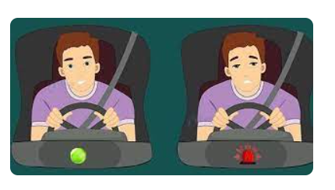
3. Model Development:
YOLO-based Detection: YOLO (You Only Look Once) will be used for real-time object detection of key features like head tilts, face recognition, and even the driver’s hand for automatic call detection. The YOLO model will be fine-tuned using the custom dataset to improve accuracy in detecting these features.
Distraction Alertness Mechanism: For detecting distraction based on head position changes, the model will identify significant left and right tilts. An alert will be triggered when these actions are detected, indicating potential distraction or drowsiness.
Automatic Call Detection: It will track phone use by detecting specific hand movements and facial cues corresponding to picking up or using a phone. This will be linked to an alert system that notifies the driver when the system detects possible phone usage while driving.

Slide 18
4. Model Training:
Training the YOLO Model: Using the labelled dataset, the YOLO model will be trained to detect key features such as head movements, eye blinks, and phone usage. Pre-trained YOLO weights will be fine-tuned to the specific features related to driver drowsiness.
Combining Multiple Features: Once individual models are trained, they will be combined in a multi-modal system. This hybrid system will take into account various features (eye activity, head position, and phone usage) to determine the driver’s drowsiness level.
5. Real-Time Alert System:
Driver Monitoring: It will be deployed for real-time monitoring using a camera and sensors that track the driver’s eye activity, head tilt, and hand movements.
Alert Generation: The system will generate alerts when drowsiness signs are detected, such as eye closure (PERCLOS), excessive blinking, head tilts, or phone usage.

Slide 19
ALGORITHM USED IN DETAIL
YOLOv5 for Object Detection:
Speed and Accuracy: YOLOv5 is known for its real-time processing capabilities and high detection accuracy.
Core Engine: Serves as the fundamental algorithm for identifying objects within the input data (likely images or video).
Confusion Matrix for Performance Evaluation:
Detailed Analysis: Provides a comprehensive view of the model's prediction accuracy.
Error Identification: Helps pinpoint specific areas where the model struggles (e.g., confusing certain object classes).

Slide 20
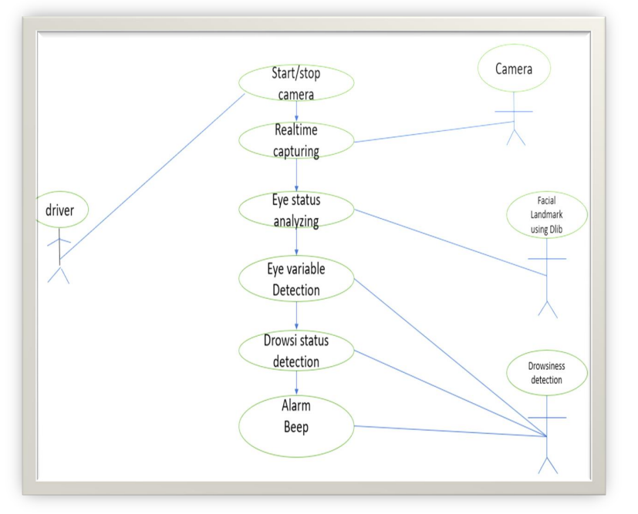
Project Design – Use Case Diagram

Slide 21
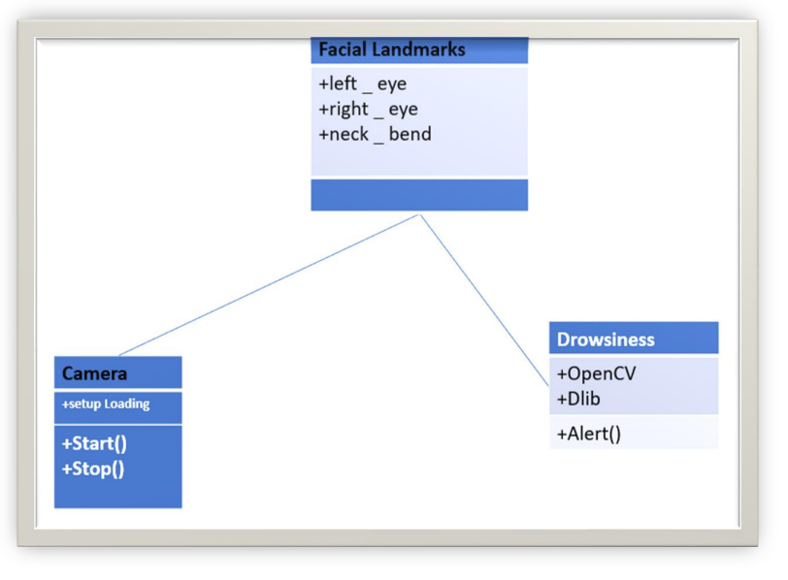
Class Diagram

Slide 22
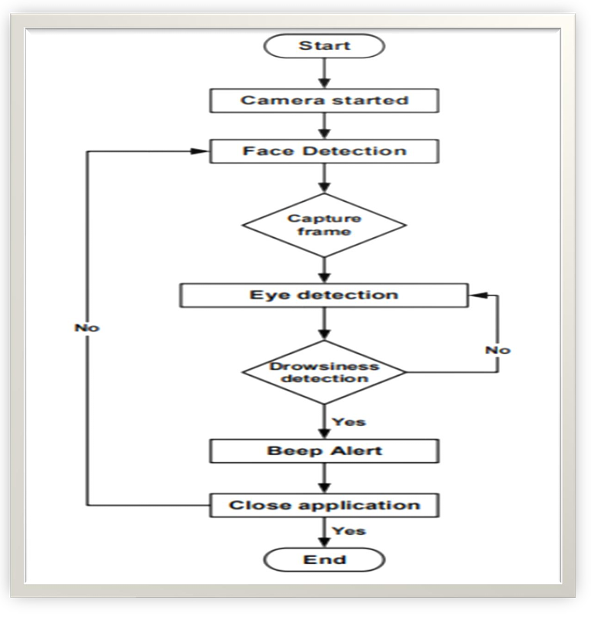
Activity Diagram

Slide 23
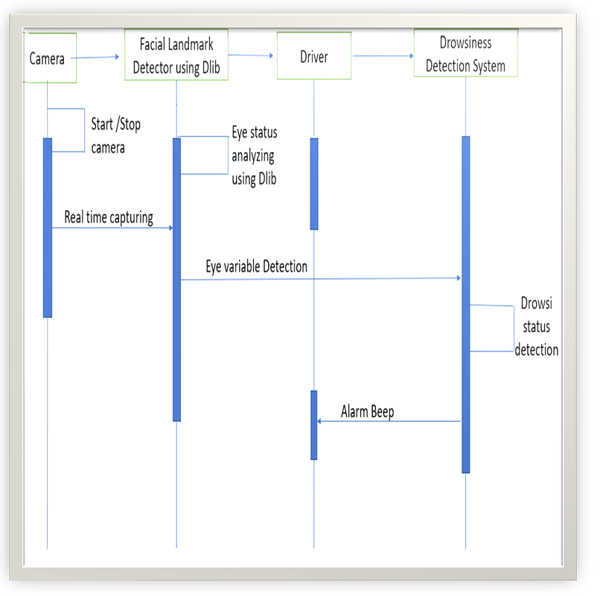
Sequence Diagram

Slide 24
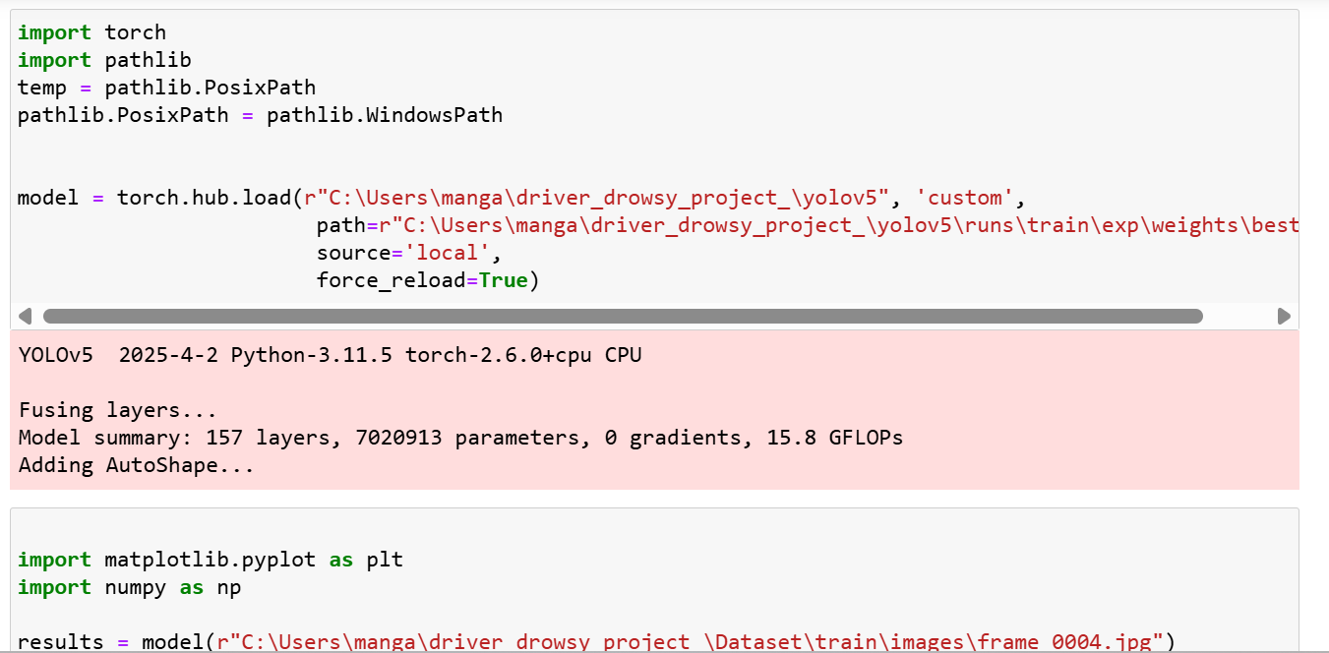
IMPLEMENTATION (CODING)

Slide 25
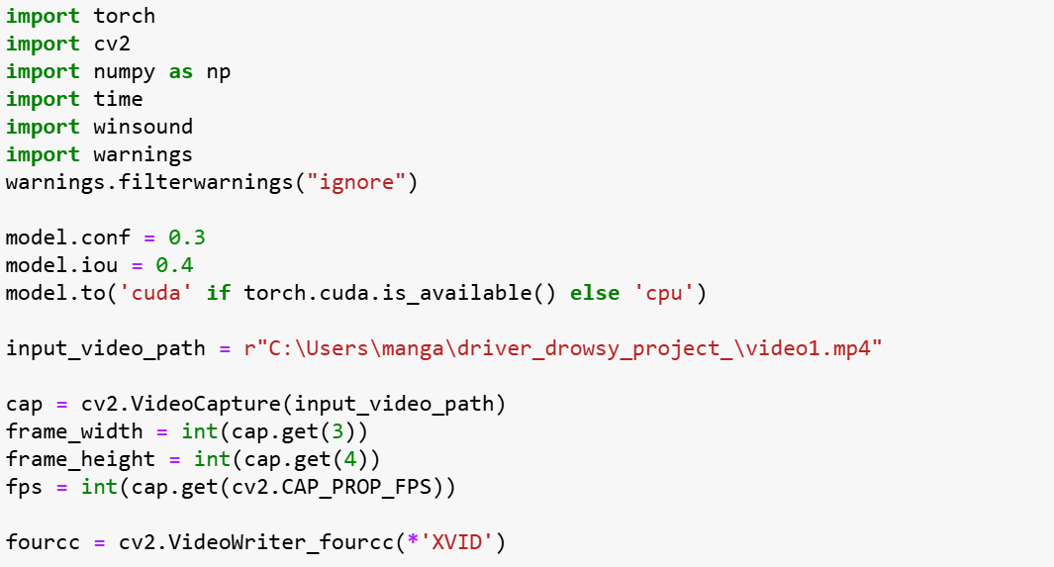
IMPLEMENTATION(CODING)

Slide 26
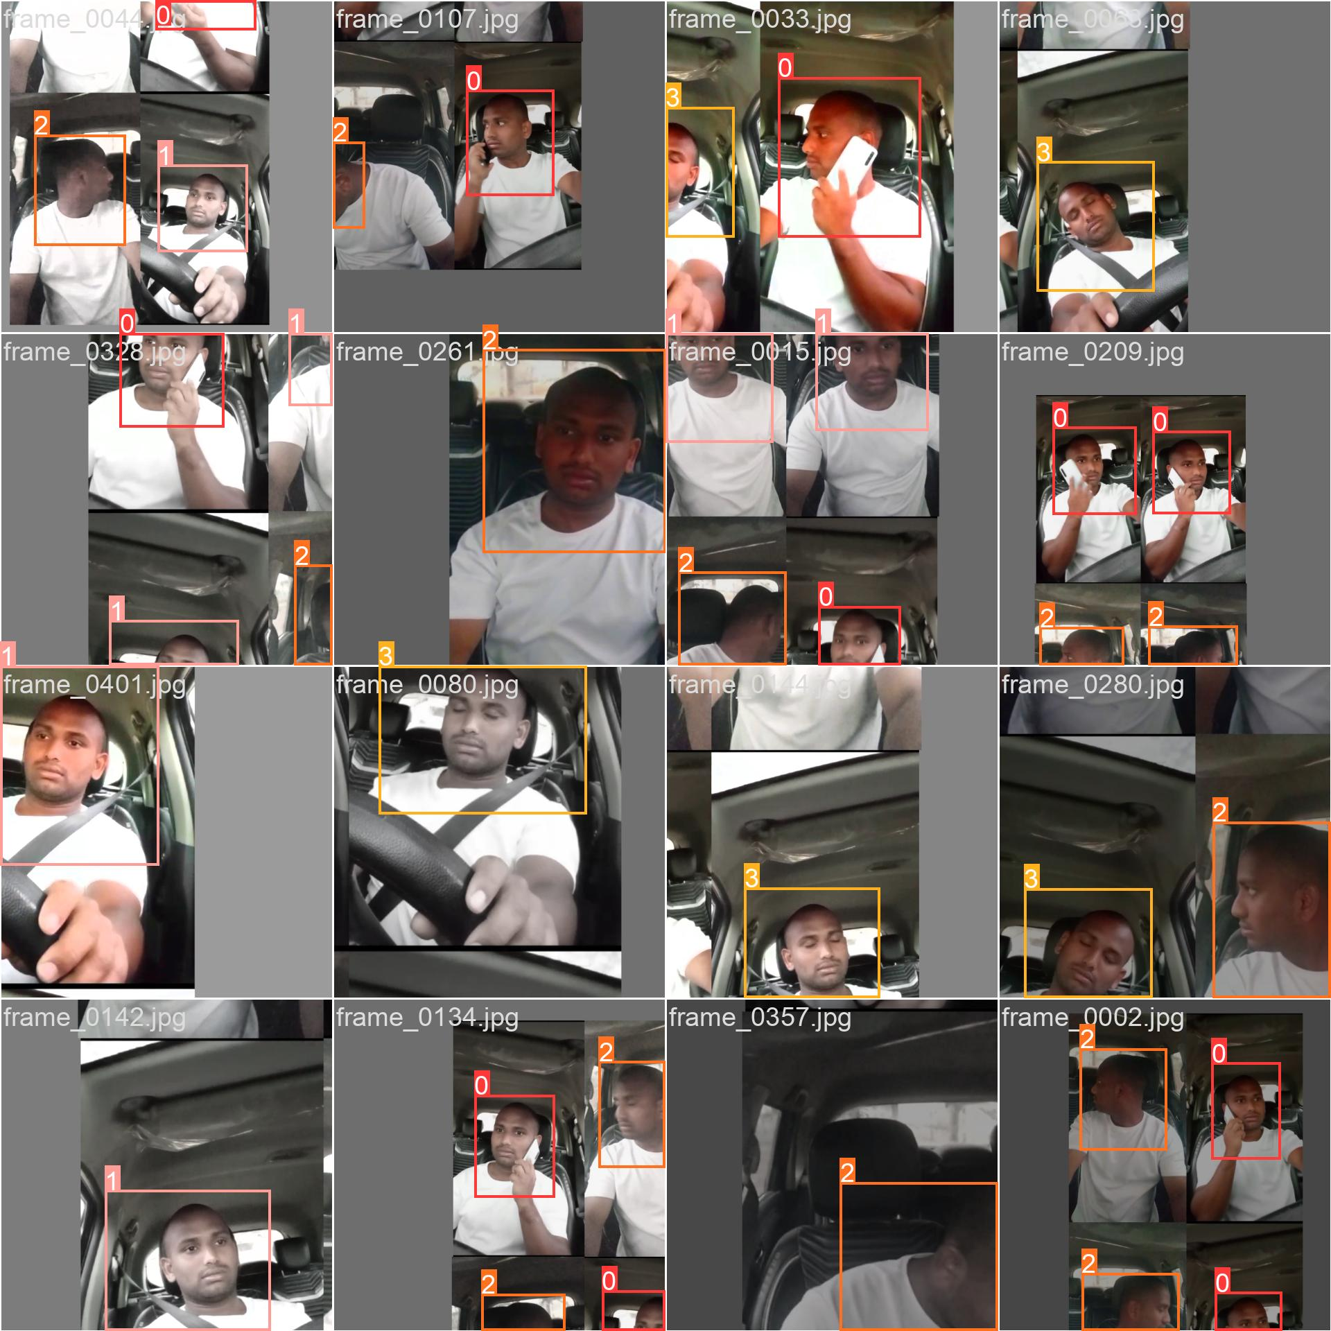
RESULTS & COMPARISON

Slide 27
SUMMARY
A vision-based driver drowsiness detection framework leverages YOLO V5 for real-time monitoring, enhancing road safety. It detects key indicators of fatigue, including eye closure, and head tilting. Additionally, the system incorporates advanced features such as automatic call detection and distraction monitoring to ensure comprehensive driver awareness. By utilizing deep learning techniques, it accurately identifies drowsiness-related behaviors and provides immediate alerts, reducing accident risks. The framework is designed for adaptability across diverse driving conditions, offering a non-intrusive solution for real-world implementation. Its integration with edge computing enables low-latency processing, ensuring efficient performance and improving overall traffic safety.

Slide 28
REFERENCES
Ahmet Kolus, A. “A Systematic Review on Driver Drowsiness Detection Using Eye Activity Measures”, IEEE Access, vol. 12,pp. 97969 to 97993, 2024.
Sharma, S., & Kumar, S. “A Survey on State-of-the-Art Drowsiness Detection Techniques. Journal of Intelligent Transportation Systems”pp. 61904 to 61919,2021.
Gupta, M., & Sinha, S. “A Systematic Review of Physiological Signals-Based Driver Drowsiness Detection Systems, Sensors”,pp. 1229 to 1259,2021.
Singh, R., & Jain, S. “A Review of Recent Developments in Driver Drowsiness Detection Systems”, International Journal of Automotive Technology,2021.
Gül, O., & Yılmaz, R. “A Review of Driver Drowsiness Detection Systems: Techniques and Future Directions”, International Journal of Human-Computer Interaction ,2021.

Slide 29
REFERENCES
Bhardwaj, P., & Saha, S. “A Study on Real-Time Driver Drowsiness Detection System Using Eye and Physiological Signals”, Journal of Advanced Transportation, pp.1 to 11,2018.
Krishnan, R., & Manikandan, S. “Driver Drowsiness Detection Using EEG and Eye Tracking Systems”, Journal of Electrical Engineering & Technology , pp.15312 to 15323,2020.
Gupta, R., & Thakur, M. “Real-Time Drowsiness Detection: A Machine Learning Approach for Improved Road Safety”, Proceedings of the International Conference on Machine Learning,pp.605 to 616, 2021.
Bedi, P., & Singh, D. “Drowsiness Detection System Using YOLO-Based Real-Time Object Detection and Deep Learning”, Journal of Intelligent Systems, pp.605 to 616,2019.
Geng, X., & Zhang, Z. “Driver Drowsiness Detection Based on Deep Learning and Facial Feature Extraction”, Sensors ,2021.
Kumari, R., & Shukla, A.A Comparative Review of Driver Drowsiness Detection Techniques. Journal of Control, Automation and Electrical Systems (2020).

Slide 30


